Slide 1
Architecture of Database Management System

Slide 2
Early Two Level Architecture
Early proposal for a standard terminology and general architecture for database systems was produced in 1971 by the DBTG (Data Base Task Group)
Appointed by the Conference on Data Systems and Languages (CODASYL, 1971).
Recommend two level approach.

Slide 3
Schema
Subschema

Slide 4
Schema
A map of the overall logical structure or description of the database .
It gives the names of the entities, attributes and specifies the relationships among the entities.
A schema is defined as an outline or a plan that describes the records and relationships existing at the particular level.
The schema is sometimes called the intension of the database, while an instance is called an extension (or state) of the database.
UCS310-Database Management Systems

Slide 5
Subschema
A map of application programmer’s view of the data he/she uses.
It is a subset of the schema having the same properties that a schema has. It allows the user to view only that part of the database that is of interest to him. They are values of a table at a particular time.
UCS310-Database Management Systems

Slide 6
Three Level Architecture
There are following three levels or layers of DBMS architecture:
♦ External Level
♦ Conceptual Level
♦ Internal Level

Slide 7
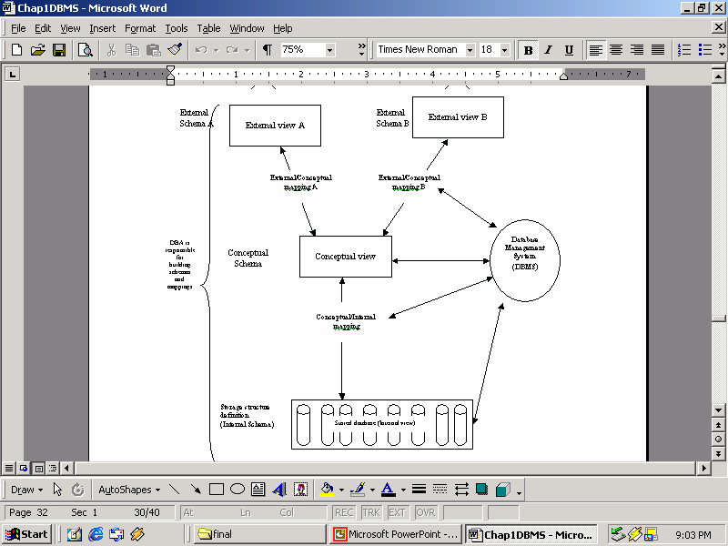

Slide 8
External Level or View level
It is the users’ view of the database. This level describes that part of the database that is relevant to each user.
For example, one user may view dates in the form (day, month, year), while another may view dates as (year, month, day).

Slide 9
Conceptual Level or Logical level
It is the community view of the database.
This level describes what data is stored in the database and the relationships among the data.
It represents:
All entities, their attributes, and the relationships among them;
The constraints on the data;
Security and integrity information.

Slide 10
Internal Level or Storage level or Physical Level
It is the physical representation of the database on the computer.
This level describes how the data is stored in the database.
The internal level is concerned with such things as:
Storage space allocation for data and indexes;
Record descriptions for storage (with stored sizes for data items);
Record placement;
Data compression and data encryption techniques.

Slide 11
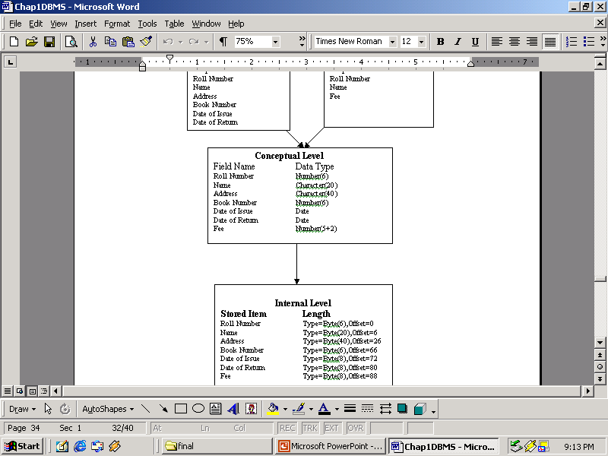

Slide 12
Mapping between Views
External/Conceptual Mapping:
A mapping between the external and conceptual views gives the correspondence among the records and the relationships of the external and conceptual views.

Slide 13
Conceptual/Internal Mapping:
Conceptual schema is related to the internal schema by the conceptual/internal mapping. This enables the DBMS to find the actual record or combination of records in physical storage that constitute a logical record in conceptual schema.

Slide 14
View 1
(input screen)
View 2
(report)
View m
(transaction)
Conceptual Schema
Physical Schema
UCS310-Database Management Systems

Slide 15
Data Independence-Achievement of Layered Architecture of DBMS
There are two kinds of data independence:
♦ Logical data independence
♦ Physical data independence
Logical data independence
  Logical data independence indicates that the conceptual schema can be changed without affecting the existing external schemas. Ability to modify the conceptual schema without causing application programs to be re-written.
  Modifications at conceptual level are necessary whenever the logical structure of the database is altered.

Slide 16
Physical data independence
  Physical data independence indicates that the physical storage structures or devices could be changed without affecting conceptual schema. Ability to modify the physical schema without causing application programs to be re-written.
  Modifications at physical level are occasionally necessary in order to improve performance.
  Note: logical data independence is more difficult to
  achieve than physical data independence,
  because application programs are heavily
  dependent on the logical structure of the data,
  they access.

Slide 17
Ex: Thapar Course Registration Database
Conceptual schema:
student (st_id: string, name: string, birthdate: date, gender: character,
pa_l1: character, pa_l2: character, pa_l3: character,
la_l1: character, la_l2: character, la_l3: character,
cugp: integer, cup: integer, cgpa: real)
course (courseno: string, cname: string, credits: integer,
lect_h: integer, tut_h: integer, pract_h: integer)
instructor (instructor_id: string, name: string, design: string, group: string,
specialization: string, chamber_no: string, tel_no: integer)
course_info (course_no: string, enrollment: integer, sections: integer)
st_course_reg (stid: string, course_no: string, section: integer,
sem: integer, year: string, grade: string)
inst_course_reg (instructor_id: string, courseno: string, section: integer,
sem: integer, year: string)
UCS310-Database Management Systems

Slide 18
Ex: Thapar Course Registration Database
External Schema (View):
course-allotment (instructor_id: string, group: string,
specialization: string,
course_no: string, section: integer)
course-reg (st_id: string, course_no: string,
section: integer)
grades (st_id: string, course_no: string,
grade: string)
UCS310-Database Management Systems

Slide 19
Ex: Thapar Course Registration Database
Physical schema:
  Relations stored as unordered files.
  Indexes on column(s) of relations (tables).
UCS310-Database Management Systems

Slide 20
Metadata or Data Dictionary
A metadata (also called the data dictionary) is the data about the data.
Data dictionary is a file that contains meta data. i.e., data about data.
Data dictionary file is consulted before actual data is read or modified in the database.

Slide 21
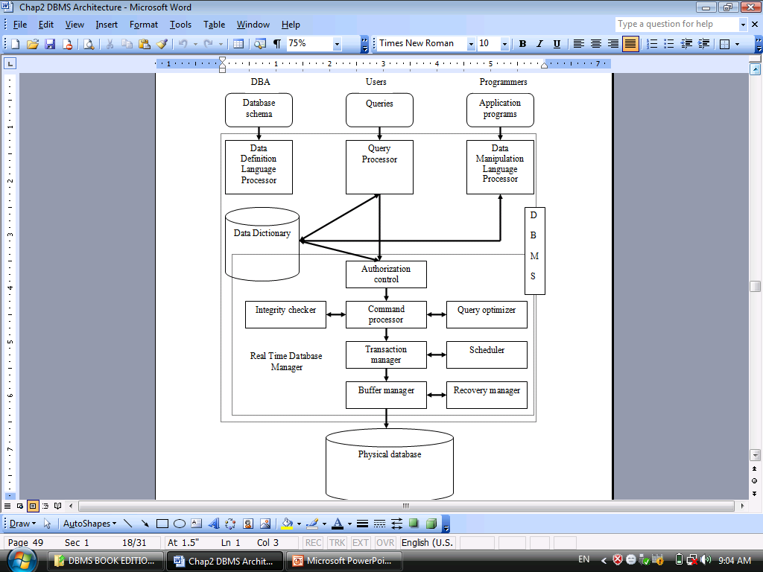
Components of a DBMS

Slide 22
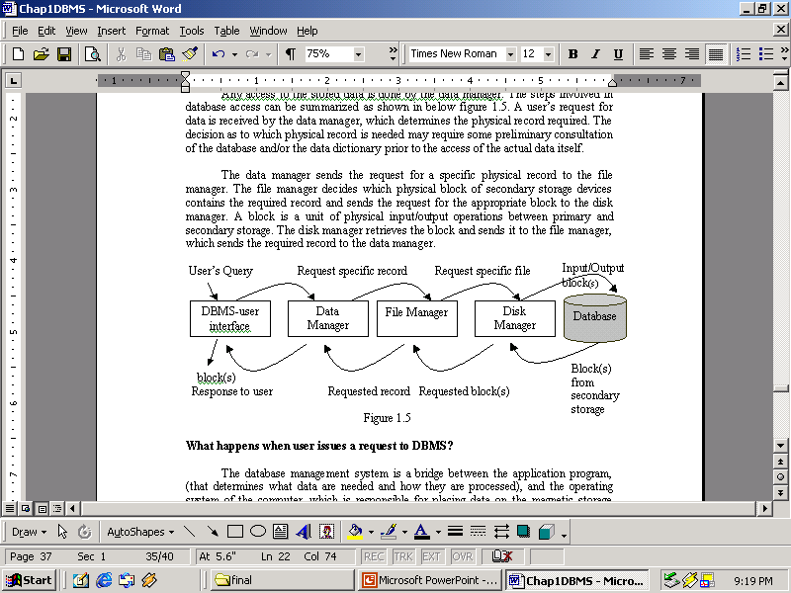
The Procedure for Database Access

Slide 23
END

